Slide 1
Caterpillar Challenge HackIllinois 2020
February 28, 2020

Slide 2



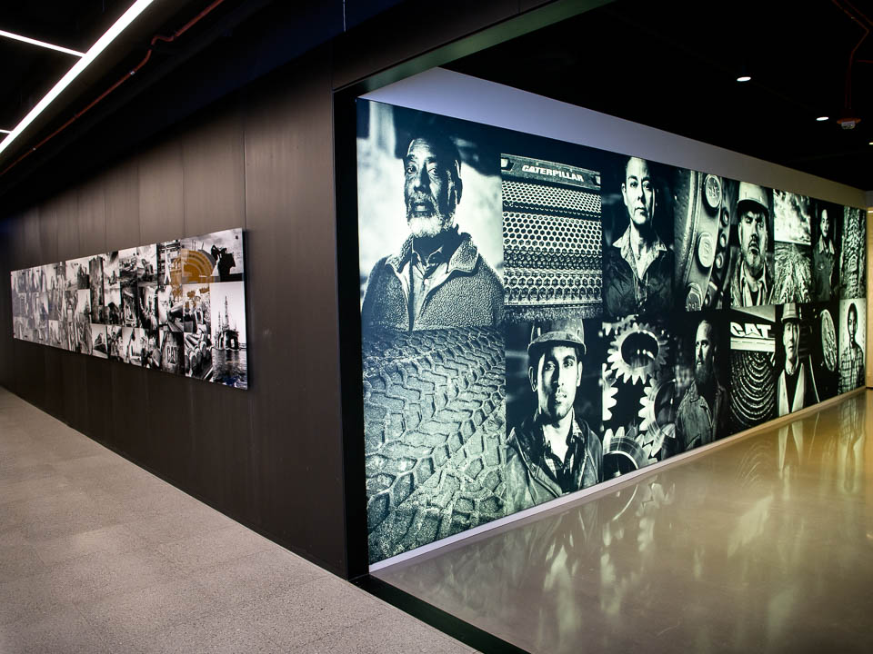

Congratulations – You have won….
$300 Amazon Gift Card
(Per individual team member)
2 Team VIP Experiences with Caterpillar
(including tech leader networking, machines/technologies overviews and physical Cat swag bags – transportation will be included)
Digital Hub Visit (Chicago) & Another Tech Center Visit
Winning Team:
Judging Criteria. The criteria for the assessment of the submissions by the judges will be provided on the Hack Illinois site.
Caterpillar Inc. has the right to substitute the prizes with other prizes of similar value. Any type of recognition such as prizes shall be at the sole discretion of Caterpillar Inc. based on the judging criteria, and shall be final and incontrovertible.
Prior to claiming a prize, you must complete and execute any necessary form(s) presented by or on behalf of Caterpillar Inc. for any prize. All taxes (federal, state, and local) on or connected with any prize, and the reporting consequences thereof, are solely the responsibility of that prize winner, unless Caterpillar Inc. communicates to the prize winners some other process or requirement. Caterpillar Inc. reserves the right to withhold and remit to the appropriate taxing authorities the amount of any taxes due. Caterpillar Inc. is not responsible for and will not replace any lost, broken or stolen prizes.

Slide 3


Slide 4
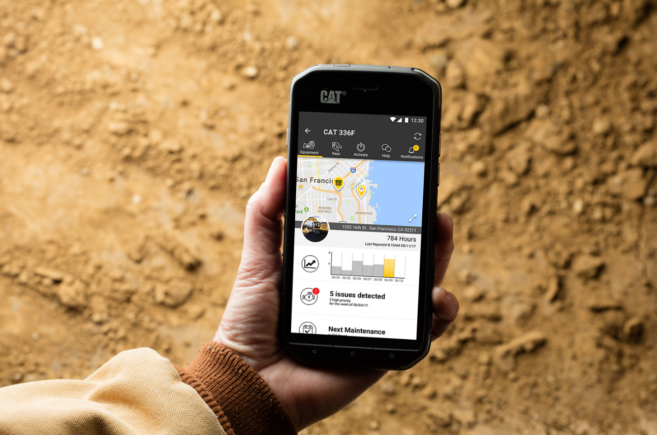
The Cat© App – Services that enhance world-class machines

Slide 5
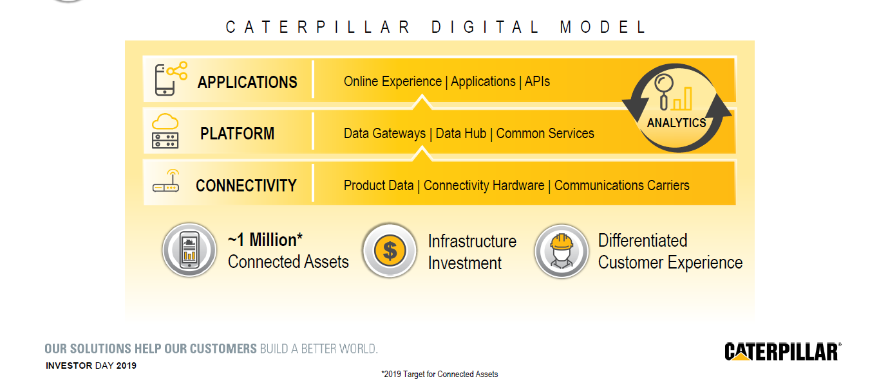
Our Stack

Slide 6








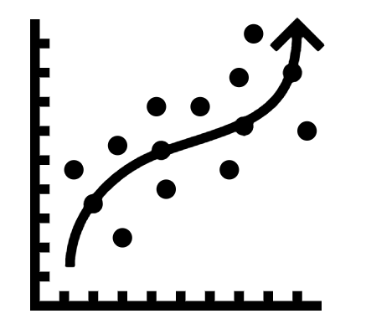





Stranger Things... In Data
IoT Machine Learning Analytics Challenge
Anomaly Detection
Detect abnormalities in operation
Find in-range failures
Channel Predictions
Determine channel relationships
Predict channel outputs
Virtual sensors
Out of Range Signals
Find out of range signals from historical max/min values
Understand the Data
Total channels per file
Max/Min/Avg of channels
Total data points
Deep Learning
Regression
Machine Learning
ETL
ETL
#sponsor – Caterpillar CaterpillarHackIllinois

